Slide 1
TIGHT CLUB PRESENTS
AVERAGE FACULTY EXPERIENCE

Slide 2
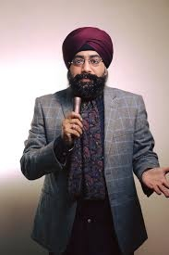
DR. BIGDEEP SINGH
Famous line : mummy coffee kaisi hain
Height - 5 foot and 3 inches.
Achievements –
Calls everyone by their correct names.
Called Lady CR at Plassio for Research purposes
Teaches very fast (Completed syllabus in one week)
Hobby – Revising what is taught in class and asking for doubts in every 3 mins.
Obsession – SDLC Life Cycle, Capstone Project, Lady CR.

Slide 3
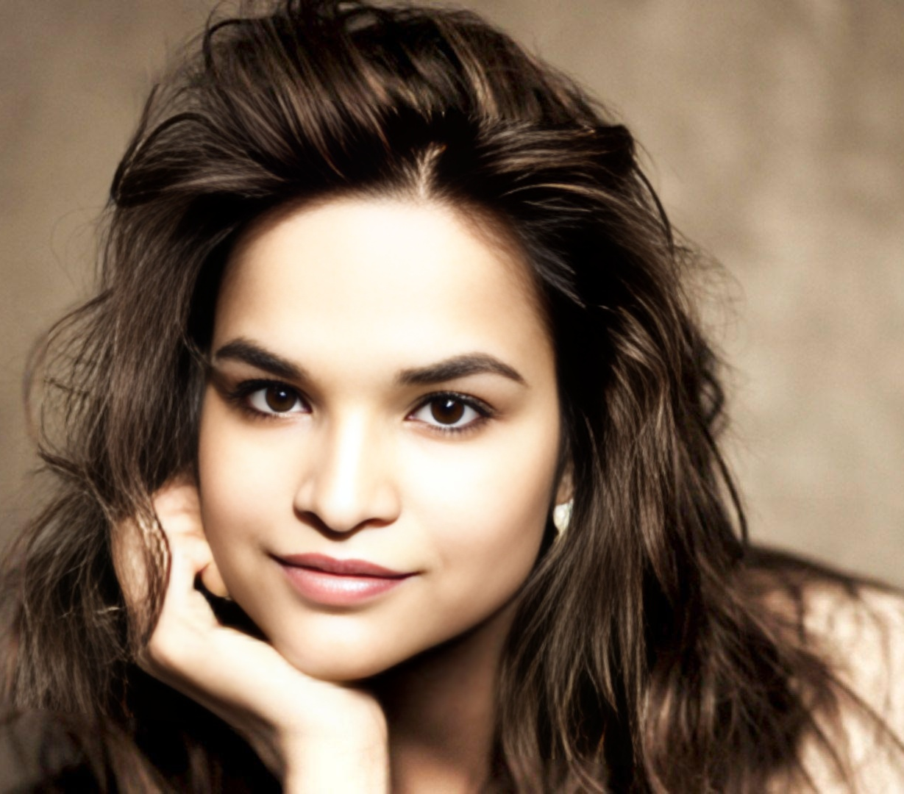
MONACO JAIN
Famous line :Entry karke aao.
Height - 2’5 (Shawty)
Achievements –
Successfully sent Insta Follow Request to all Students
Tells students to stay quiet, and starts bitching on call.
Can name 5 books
Rival - Mess Wale Bhaiya
Obsession – Lunch Time, Register, Library Assistant.

Slide 4
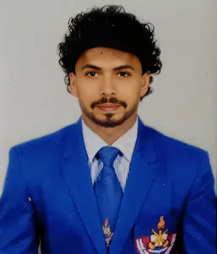
MR. ANDREW NARAYAN SINGH
Famous line : Kuch kehna hai aap log ko ??
Height - 6’8
Achievements –
Played Ranji Trophy in Football Division
Completes 8 Rounds Everyday
BCCI ate his career
Rizzes every girl unsuckcessfully.
Hobby – Thinks he is from Army, Uploads Sigma Pics on Instagram (Part Time Influencer)
Obsession – Breaking Off, Being Injured.
Homie – Deepak Maurya.

Slide 5
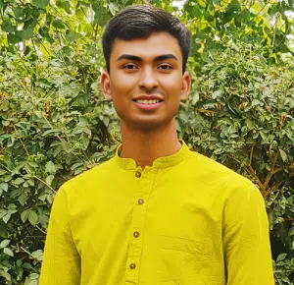
RASMALAI
POR – Yoga Minister at Axios Famous line : Mehsoos kijiye apne sharer mein hone wale changes ko.
Height - 5’8 (Stretchable)
Achievements –
Wakes up at 5 am
Can become anything – chair, cow, camel, bridge.
Hobby – Also thinks he is from Army, Breathing In and Out
Obsession – Andrew Narayan Singh (Cutie Waifu)

Slide 6
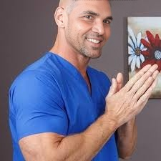
DR. PRASHANTH SINS
Famous line : Baccha log Aexplore and Aenjauy
Height - 10 rem.
Achievements –
Professional Josh Talk English Speaker
Full stack Developer at Exam Cell
Cracked a Joke once.
Thinks University Project is Real.
Rival – ChatGPT, Claude, Etc
Obsession – Springboot, Bootstrap, Online Classes

Slide 7
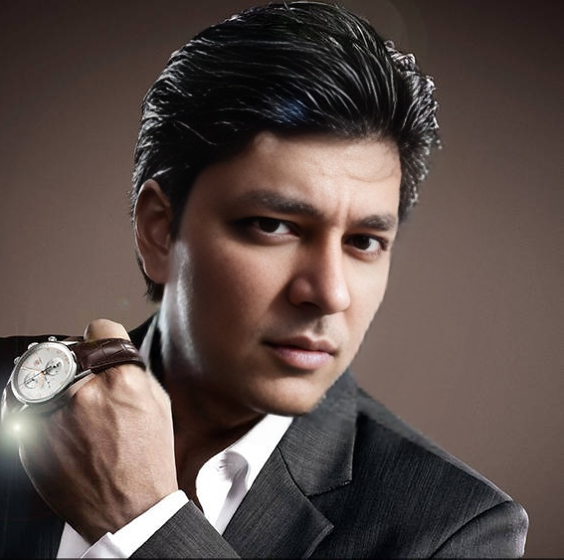
DR. SHAHRUKH KAUSHIK
SENIORS NE BOLA HAI ISPE KUCH MAT LIKHO
*Bas Ghaas Kharab mat karna

Slide 8
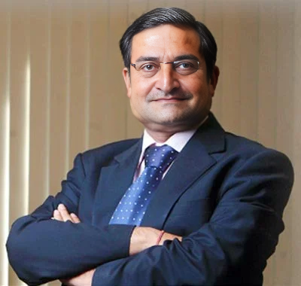
THANK YOU!!
DM FOR MORE PHOTOS

